Slide 1
Quick sort And Merge sort Algorithms
Bhushan D. Shinkar

Slide 2
Sub Topics
What is algorithm in programming ?
Example Of Algorithm.
Quick sort Algorithm.
Merge Sort Algorithm.

Slide 3
what is algorithm in programming ?
A programming algorithm is a computer procedure that is a lot like a recipe (called a procedure) and tells your computer precisely what steps to take to solve a problem or reach a goal.
A set of rules to be followed in calculations or other problem-solving operations, especially by a computer.
An algorithm is a step by step method of solving a problem. It is commonly used for data processing, calculation and other related computer and mathematical operations.

Slide 4
EX:- 1) Write an algorithm to add two numbers entered by user
Step1 :- Start
Step 2 :- Declare variables num1, num2 and sum.
Step 3 :- Read values num1 and num2.
Step 4 :- Add num1 and num2 and assign the result to sum.
sum←num1+num2
Step 5 :- Display sum
Step 6 :- Stop

Slide 5
Quick Sort
Quick sort is a sorting algorithm and also known as a Partition-Exchange Sort. Quick sort is a comparison sort.
Sorting algorithm is based on partitioning of array of data into smaller arrays. A large array is partitioned into two arrays one of which holds values smaller than the specified value, say pivot, based on which the partition is made and another array holds values greater than the pivot value.

Slide 6
Quick Sort steps
Steps :-
1) Select An Element in the array as Pivot.
2) partition the array so that all items less than the pivot are to the left of the pivot, and all the items greater than the pivot are to the right.
3) sort the Left half.
4) Sort the Right half.

Slide 7
How it Works ?
1) Step 1 :- Choose a pivot
5
5
3
9
8
7
2
4
1
2) Step 2 Lesser values go to the left, equal or greater values go to the right
3
2
4
1
5
5
9
8
7
3) Step 3: Repeat from step 1 with the two sub lists
1
7
3
3
4
5
5
9
8
3
3
3
3
3
2

Slide 8
Time Complexity :-
Worst case:-
O(n^2) This happens when the pivot is the smallest (or the largest) element. we repeat recursively the procedure for n-1 elements.
Best Case:-
O(nlogn) is when the pivot is the median of the array, and then the left and the right part will have same size. There are (log n) partitions, and to obtain each partitions we do (n) comparisons (and not more than n/2 swaps). Hence the complexity is O(nlogn).

Slide 9
Advantages and Applications:-
Advantages :-
One of the fastest algorithms on average. Does not need additional memory (the sorting takes place in the array - this is called in-place processing).
Applications :-
Commercial applications use Quick sort :- generally it runs fast, no additional memory, Never use in applications which require guaranteed response time: Ex:- Life critical (medical monitoring, life support in aircraft and space craft)..etc.
LinkedIn resume updated with my recent changes.

Slide 10
Merge Sort
Like QuickSort, Merge Sort is a Divide and Conquer algorithm. It divides input array in two halves, calls itself for the two halves and then merges the two sorted halves. The merge() function is used for merging two halves. merges the two sorted sub-arrays into one

Slide 11
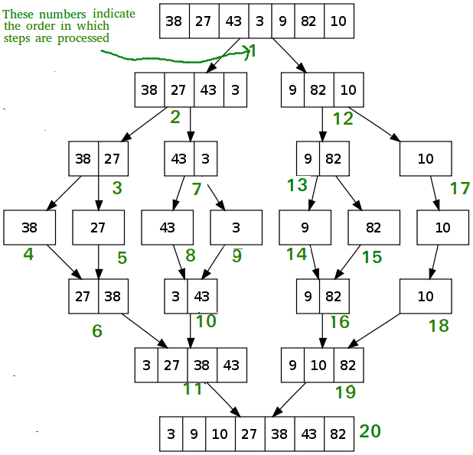
How Merge Sort Works?

Slide 12
How Merge Sort Works?
Merge sort keeps on dividing the list into equal halves until it can no more be divided. By definition, if it is only one element in the list, it is sorted. Then, merge sort combines the smaller sorted lists keeping the new list sorted too.
Step 1 − if it is only one element in the list it is already sorted, return.
Step 2 − divide the list recursively into two halves until it can no more be divided.
Step 3 − merge the smaller lists into new list in sorted order.

Slide 13
Merge sort steps
int merge_sort (int *arr, int start, int end)
if (start < end)
1. Find the middle point to divide the array into two halves:
mid = (start + end) / 2
2. Call merge Sort for first half:
merge_sort(arr, start, mid);
3. Call merge Sort for second half:
merge_sort(arr, mid + 1, end)
4. Merge the two halves sorted in step 2 and 3:
merge(arr, start, mid, end)

Slide 14
Time Complexity :-
The complexity of merge sort is O(nlogn) and NOT O(log n).
Merge sort is a divide and conquer algorithm. Think of it in terms of 3 steps -
The divide step computes the midpoint of each of the sub-arrays. Each of this step just takes O(1) time.
The conquer step recursively sorts two sub arrays of n/2 (for even n) elements each.
The merge step merges n elements which takes O(n) time.
Now, for steps 1 and 3 i.e. between O(1) and O(n), O(n) is higher. Let's consider steps 1 and 3 take O(n) time in total. Say it is cn for some constant c.
How many times are these steps executed?
Now, the height of this tree is (log n + 1) for a given n. Thus the overall complexity is (log n + 1)*(cn). That is O(nlogn) for the merge sort algorithm.

Slide 15
Advantages and Disadvantage:-
Advantages :-
It can be applied to files of any size.
Reading through each run during merging and writing the sorted record is also sequential.
The e-commerce application:-
you may seen this on e-commerce site “You might like”, they have maintained an array for all the user accounts and then whichever has the least number of inversion with your array of choice,They start recommending what they have bought or they like.
Disadvantages : -
It require Extra space because we are using temporary array while merging.

